Slide 1

FACULTY OF ENGINEERING
DEPARTMENT OF COMPUTER ENGINEERING
DEVELOPMENT AND IMPLEMENTATION OF A ROBOTIC APPLICATION FOR HUMAN INTENTION RECOGNITION USING MOTION AND HAND GESTURE
A Final Project Report Submitted in Partial Fulfillment of the Requirements for the Degree of Bachelor of Science in Computer Engineering
PRESENTATION BY:
ELEANA OSEI OWUSU — 4121230024
JOEL NII ADJETEY AHULU — 4121230020
SUPERVISOR: MR. MICHEAL XENYA
ACADEMIC YEAR: 2025/2026
GHANA COMMUNICATION TECHNOLOGY UNIVERSITY

Slide 2
PRESENTATION OUTLINE
01. Introduction, Problem Statement & Objectives
02. Literature Review & Critical Research Gaps
03. System Architecture & 6-Phase Methodology
04. Implementation & Intelligent Algorithms
05. Testing, Results & Safety Analysis
06. Conclusion, Limitations & Recommendations
07. Key References (IEEE Format)

Slide 3
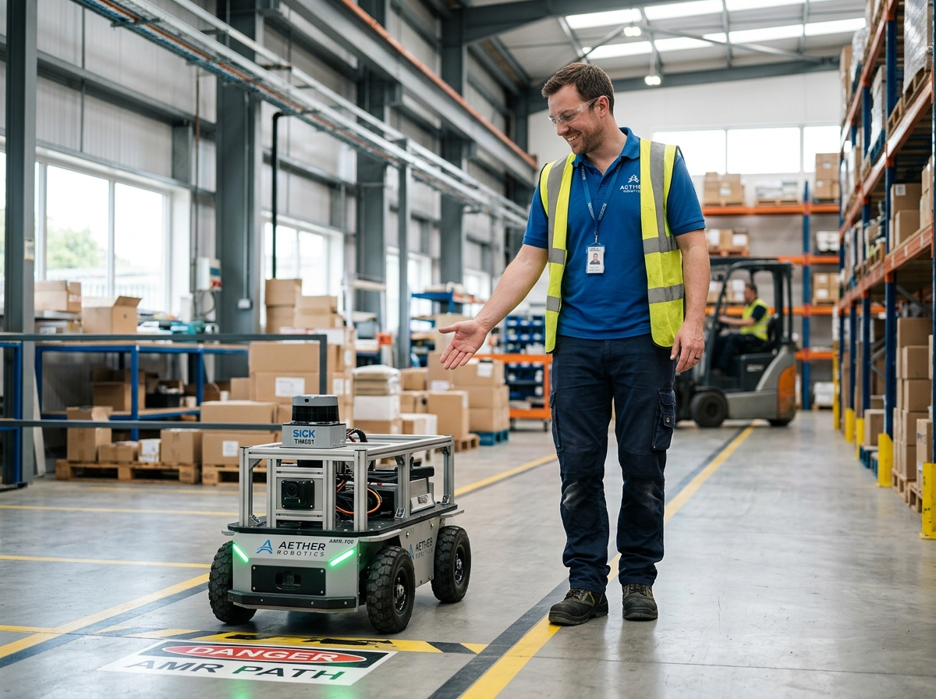
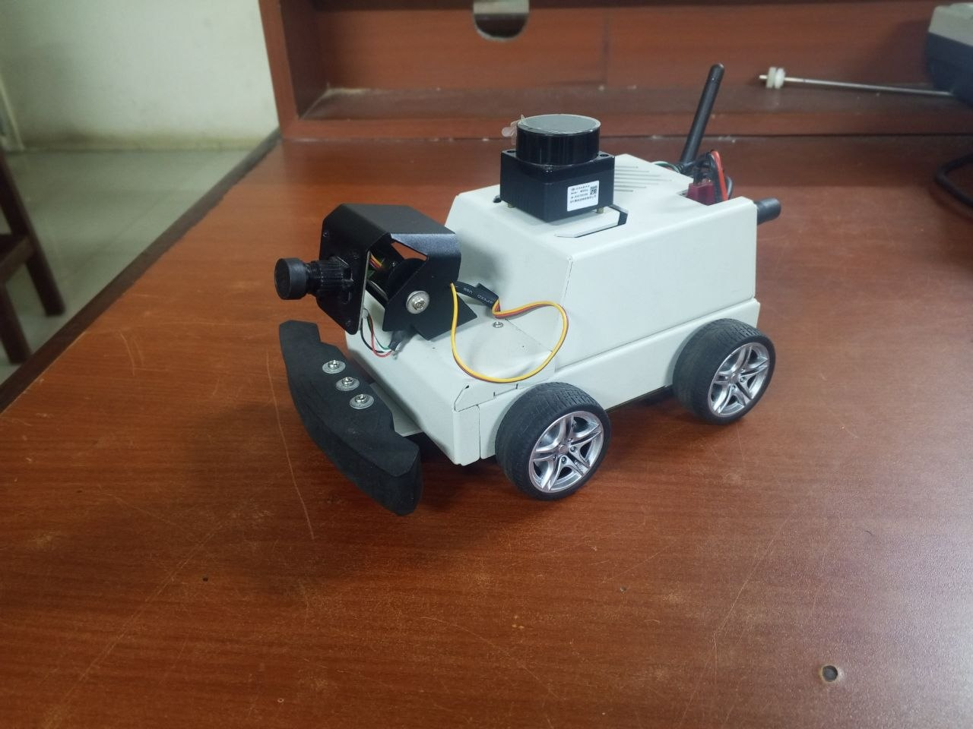
INTRODUCTION & RESEARCH BACKGROUND
Robots Working Directly with Humans
Robots are leaving safety cages to work alongside people in hospitals, warehouses, and homes. For humans and robots to coexist safely, the robot must understand where people are and respect their personal space.
Natural, Hands-Free Interaction
Instead of requiring handheld controllers, touchscreens, or keyboards, humans can guide the robot using natural hand gestures and body movement—just like signaling to a human coworker.
Fast Onboard Intelligence (No Cloud Lag)
Sending live video over the internet causes dangerous delays (>200 ms) and fails when Wi-Fi drops. In this project, all AI recognition and navigation decisions happen entirely inside the robot in real time.
Figure 1.1: Collaborative Human-Robot Interaction (HRI) in an industrial shared workspace, illustrating contactless gesture coordination.

Slide 4
PROBLEM STATEMENT
Current mobile robots separate vision recognition from active navigation, relying on remote cloud servers that suffer from high network lag (>200 ms) and connection dropouts.
In shared human-robot workspaces, this delay prevents robots from reacting in real time to human gestures, creating severe collision hazards under ISO 15066 safety standards.
PERCEPTION-ACTION GAP
Vision AI isolated from wheel motors & obstacle avoidance
(Tsitos et al., 2022)
CLOUD LATENCY HAZARD
Network lag > 200 ms & Wi-Fi drops violate ISO 15066 safe stopping margins
EDGE COMPUTING LIMIT
Heavy vision AI overheats mobile chips; demands a sub-135 ms onboard pipeline

Slide 5
PROJECT OBJECTIVES
GENERAL OBJECTIVE
To design, implement, and evaluate an edge-deployed, real-time human intention recognition and autonomous navigation system powered by ROS 2 on an embedded mobile robot.
01. Invariant Vision Pipeline
Compute 19 scale-invariant geometric features from 21 hand landmarks for real-time onboard MLP classification.
04. Supervisory Brain Node
Execute a deterministic finite state machine with 5-frame rolling consensus, active operator lock, and visual servoing.
02. Balanced 6,000-Sample Dataset
Capture and balance a custom 6-class dataset directly through the onboard camera to eliminate perspective domain shift.
05. 2D LiDAR SLAM & Nav2
Deploy real-time SLAM Toolbox mapping and the Nav2 navigation stack for socially aware, collision-free path execution.
03. LSTM Trajectory Prediction
Forecast short-horizon operator motion trajectories from continuous body pose landmarks using recurrent neural networks.
06. Empirical Safety Benchmarking
Quantify end-to-end latency (132 ms), physical classification accuracy (96.7%), and compliance with ISO 15066 safety margins.

Slide 6
LITERATURE REVIEW & RESEARCH GAPS
CRITICAL APPRAISAL OF CORE BENCHMARK STUDIES (THESIS CHAPTER 2)
Athanasios Tsitos, Maria Dagioglou & Theodoros Giannakopoulos (2022)
"Real-Time Feasibility of a Human Intention Method Evaluated Through a Competitive Human-Robot Reaching Game"
• Objective: Predict human reaching intent early to guide robot arm trajectories within a 150 ms reaction threshold.
• Methodology: Tracked hand movements with a depth camera and trained machine learning (SVM) to guide a robot arm.
• Research Gap: Confined to a static desk — lacks mobile base movement and provides no explicit hand gesture command channel.
• Project Resolution: Direct vision-to-wheels coupling for mobile navigation guided by 6 touchless hand gestures.
Jubayer Al Mahmud (2022)
"3D Gesture Recognition and Adaptation for Human–Robot Interaction"
• Objective: Classify 3D pointing and dynamic hand gestures in real time to guide robot interaction across age groups.
• Methodology: Tracked full-body joints using a Kinect sensor and trained deep learning models on 3,600 gestures.
• Research Gap: Relies on heavy cloud / GPU computing clusters; vulnerable to network lag (>200 ms) and connection drops.
• Project Resolution: Executes 100% of vision AI directly onboard a low-cost Raspberry Pi 5 with zero cloud dependency.
Y. Li, H. Zhang, Guang Yang & Shuoyu Wang (2023)
"Safe and Efficient Motion Planning for Material Transportation Robots Considering Intention Prediction of Obstacles"
• Objective: Plan collision-free mobile robot paths by predicting whether human workers will clear the hallway.
• Methodology: Fused LiDAR and camera vision to predict worker paths and adjust navigation maps in a simulator.
• Research Gap: Tested only in computer simulation — never validated on physical robot hardware; lacks touchless gesture control.
• Project Resolution: Physically validated on a real mobile robot with 2D LiDAR SLAM, active visual servoing, and ISO safety stops.

Slide 7
6-PHASE RESEARCH & IMPLEMENTATION METHODOLOGY
STRUCTURED RESEARCH & IMPLEMENTATION LIFECYCLE FROM DESIGN TO VALIDATION
PHASE 01
Mechatronics & Hardware
• Robot Platform: 4WD mobile base with geared DC motors, wheel encoders, and camera gimbal.
• Dual Processors: Raspberry Pi 5 for vision AI paired with an ESP32-S3 for real-time motor control.
• Separate Power: Dedicated battery packs powering the onboard computer and drive motors independently.
PHASE 02
Data Collection & Setup
• Custom Dataset: 6,000 total gesture images (1,000 per class) collected with the onboard camera.
• 6 Core Gestures: Navigational commands: STOP, GO, FOLLOW, LEFT, RIGHT, and BACK.
• Realistic Testing: Captured at distances between 1.0 m and 2.5 m under standard room lighting.
PHASE 03
Feature Extraction & AI Models
• Hand Keypoints: Detected 21 hand joints with MediaPipe and computed 19 normalized angles and distances.
• Neural Classifier: Compact neural network (46 KB) classifying gestures in under 2 ms on the CPU.
• Motion Predictor: Recurrent neural model (LSTM) tracking hand and body movements across consecutive frames.
PHASE 04
Robot Control & Safety
• ROS 2 Framework: Modular software nodes connecting the camera, AI models, and motor drivers.
• Decision Logic: State machine filters out accidental motions by confirming steady hand gestures.
• Emergency Halt: 2D LiDAR sensor automatically stops the robot if an obstacle is within 0.36 m.
PHASE 05
Mapping & Navigation
• Indoor Mapping: 2D laser mapping (slam_toolbox) creates a clean 5 cm resolution floor plan.
• Robot Position: Accurately tracks robot movement by combining wheel encoders with an onboard IMU sensor.
• Path Planning: Nav2 autonomous navigation plans collision-free paths with safe margins around obstacles.
PHASE 06
Testing, Results & Analysis
• Fast Response: End-to-end reaction time of 132.0 ms, comfortably below the 150 ms real-time limit.
• Live Driving Trials: 180 real-world physical tests achieving a 96.67% operational success rate.
• Safety Confirmed: Verified that the robot reliably halts before coming into contact with any human or obstacle.

Slide 8
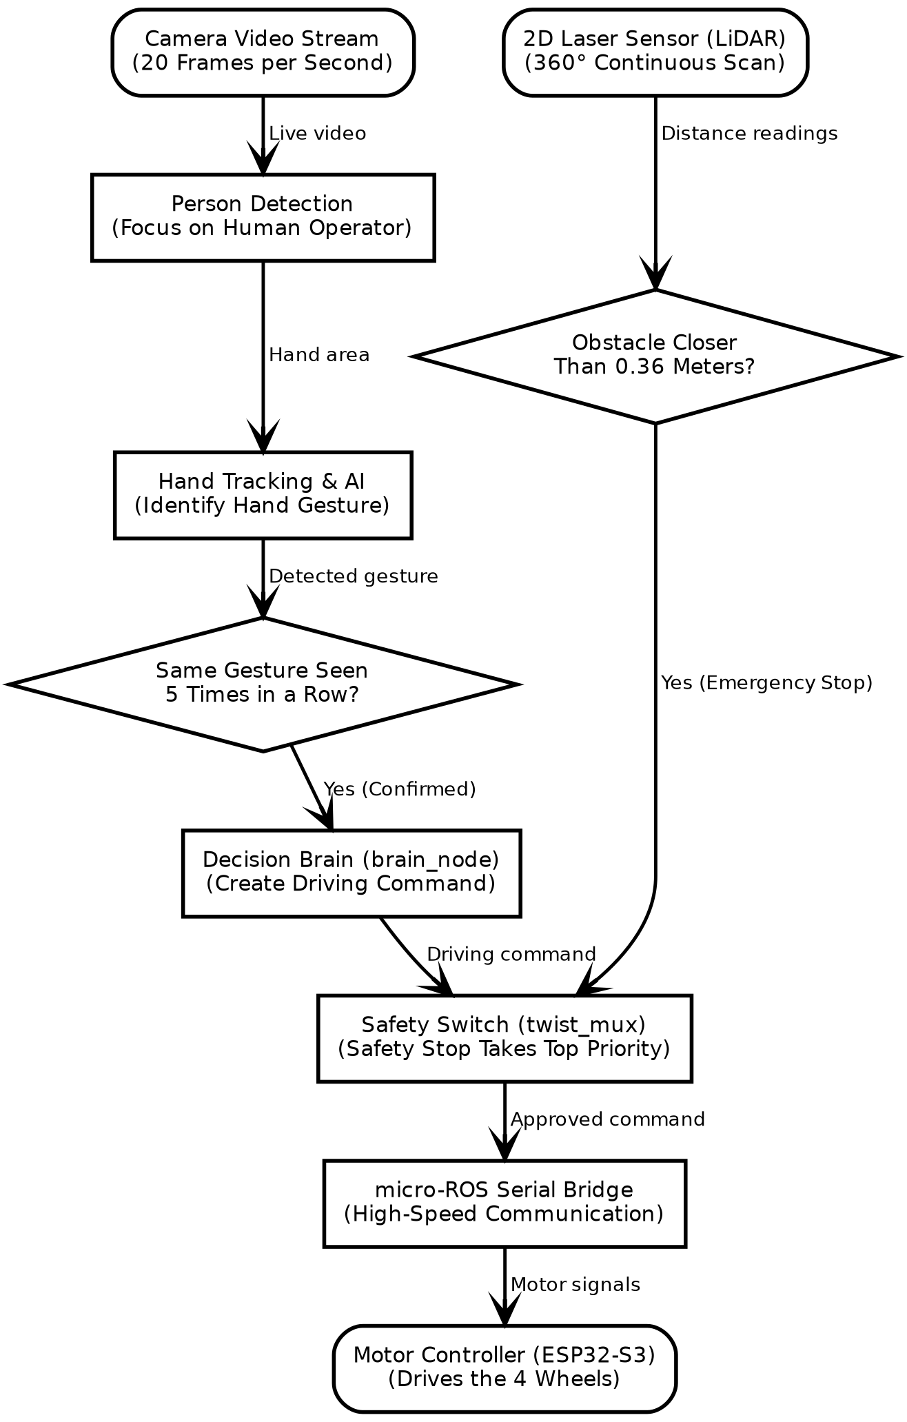
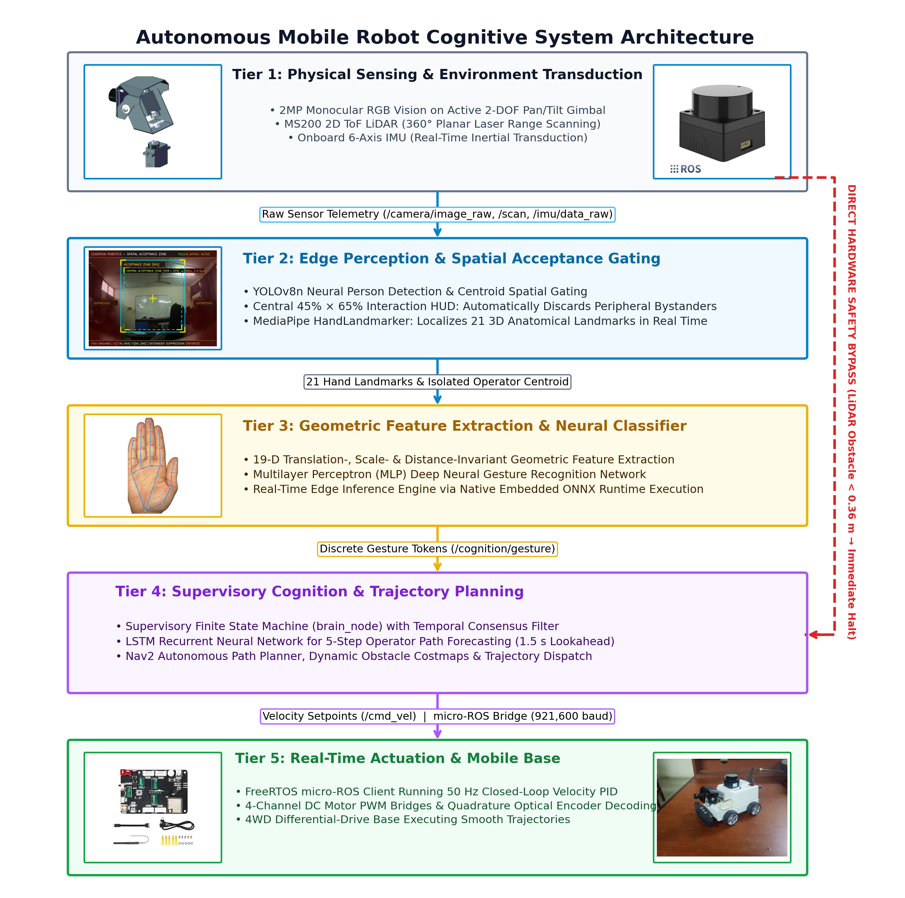
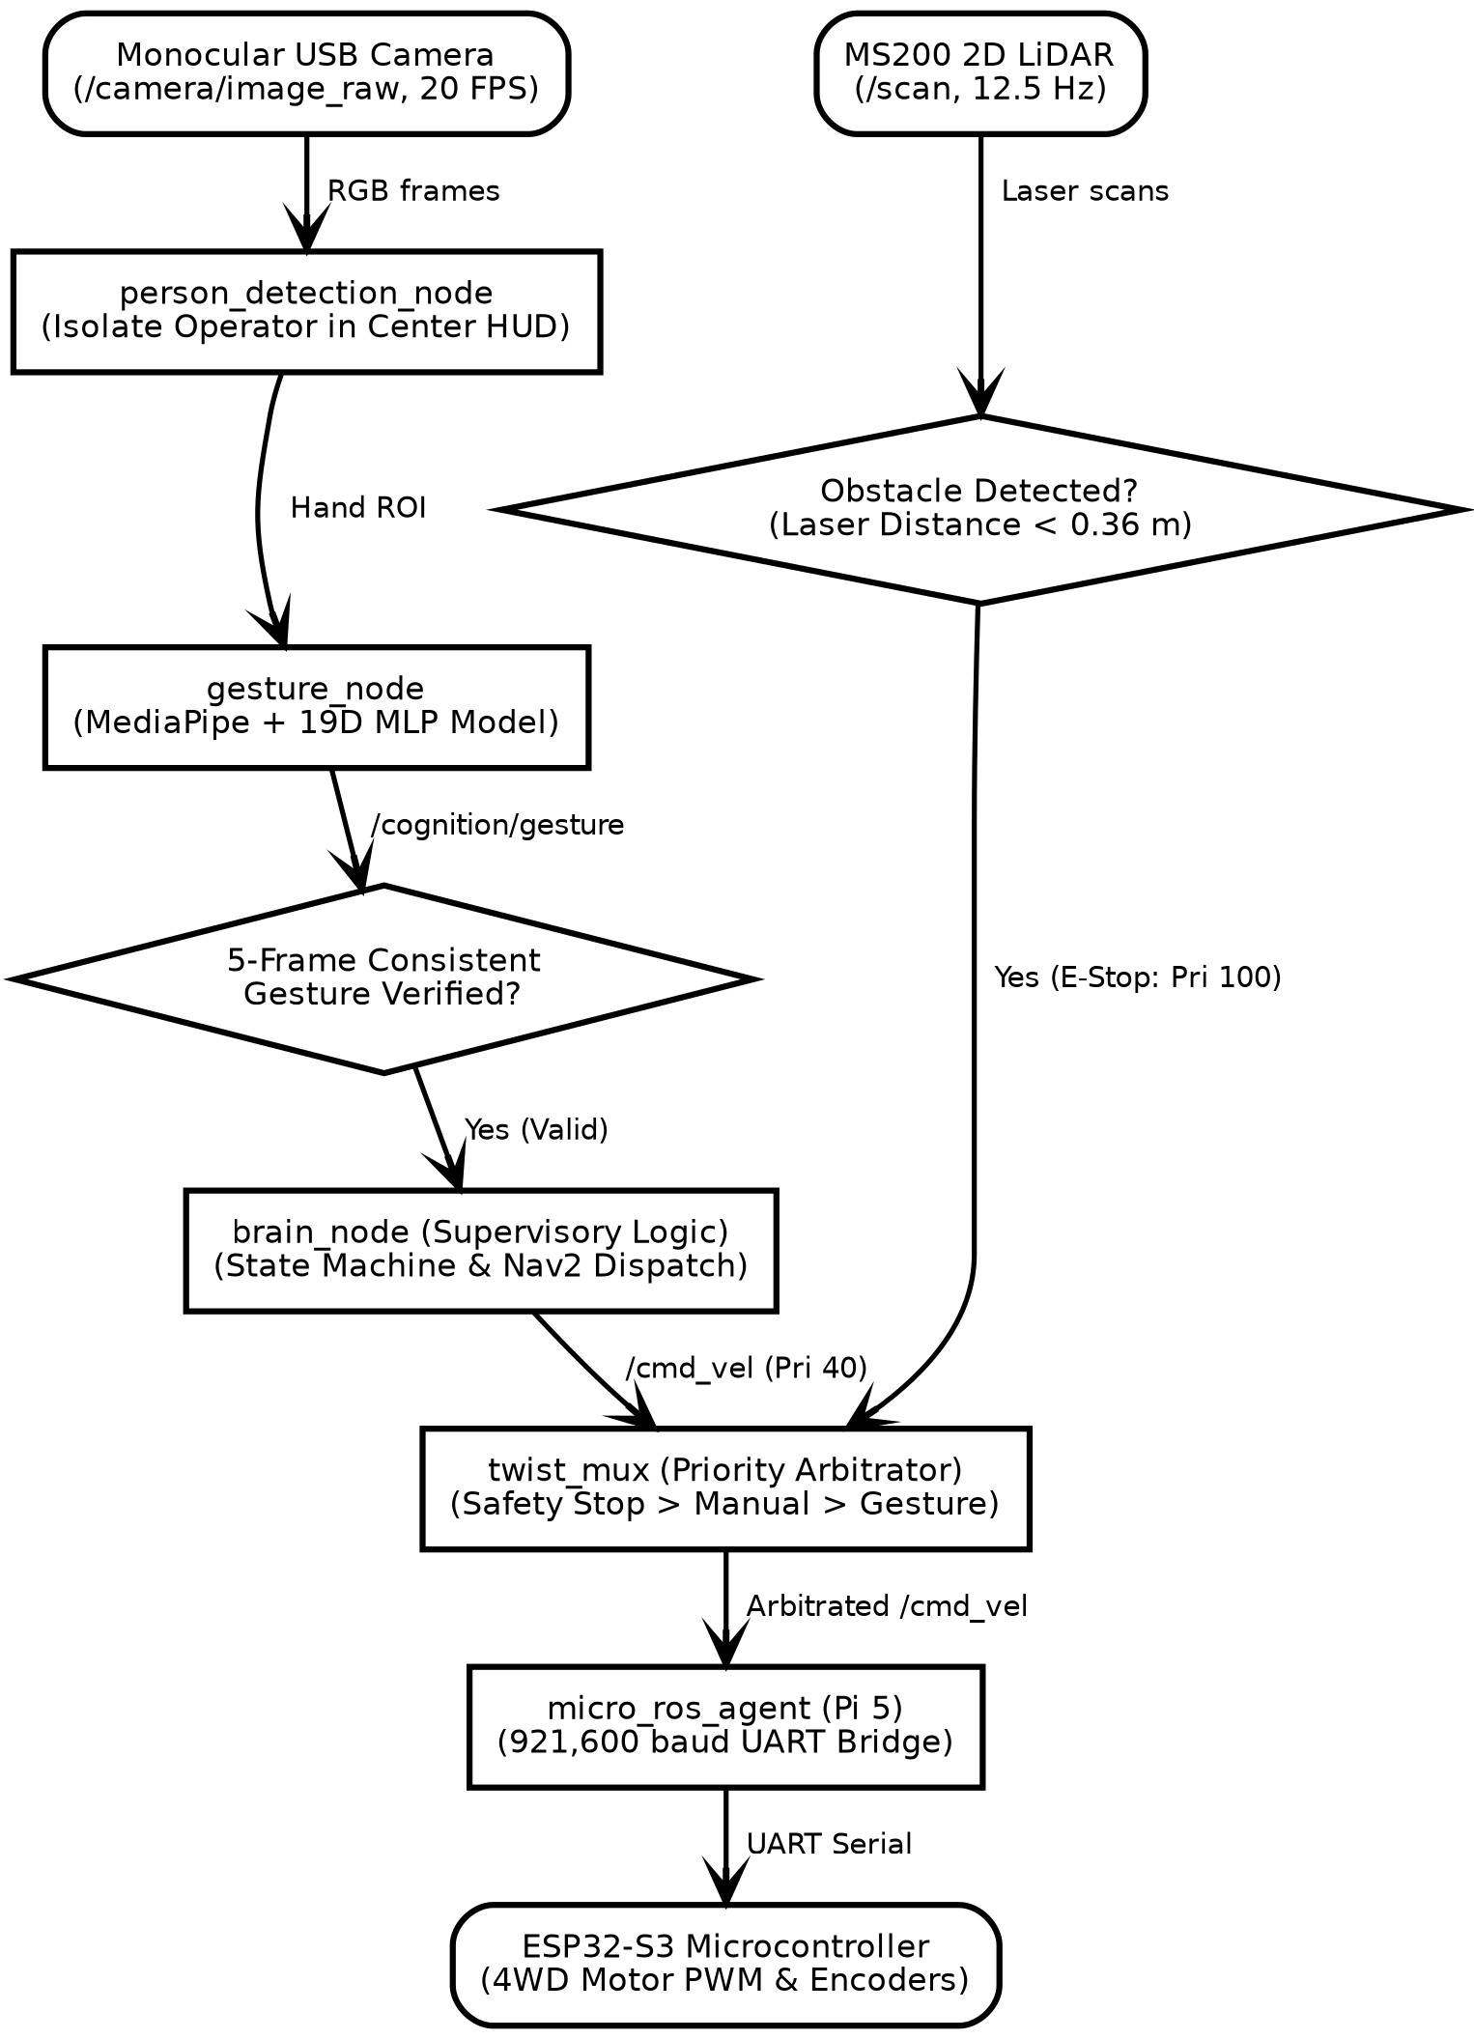
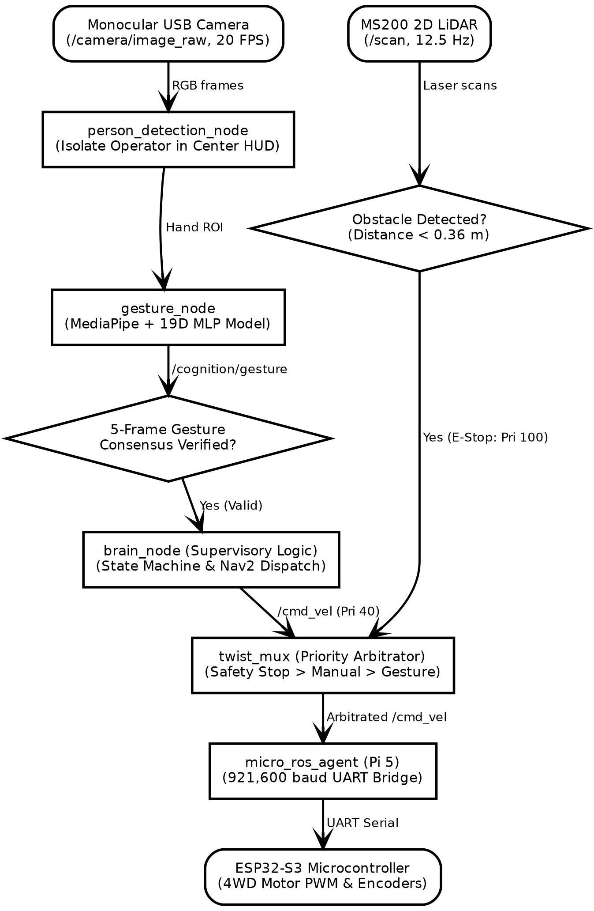
SOFTWARE ARCHITECTURE & INTER-NODE DATAFLOW
HOW THE ROBOT PROCESSES SENSOR DATA AND MAKES SAFE DRIVING DECISIONS
• System Software (ROS 2): Connects all camera, artificial intelligence, and motor programs so they exchange data reliably with low communication latency.
• Live Sensor Feeds: The camera captures live video at 20 frames per second while the laser sensor constantly scans 360 degrees for obstacles.
• Vision & Hand Tracking: Focuses on the person standing in front of the robot, locates 21 finger joints, and identifies the gesture being shown.
• Gesture Confirmation: The robot checks that it sees the exact same gesture 5 times in a row before moving, ignoring accidental hand motions.
• Safety Override: If the laser detects any obstacle closer than 0.36 meters, it automatically preempts driving commands and halts the vehicle.
• Smooth Wheel Control: Approved movement commands are transmitted directly to the motor controller board, which drives the 4 wheels smoothly.
Figure 3.1: Dataflow Pipeline from Sensor Feeds to Wheel Actuation

Slide 9
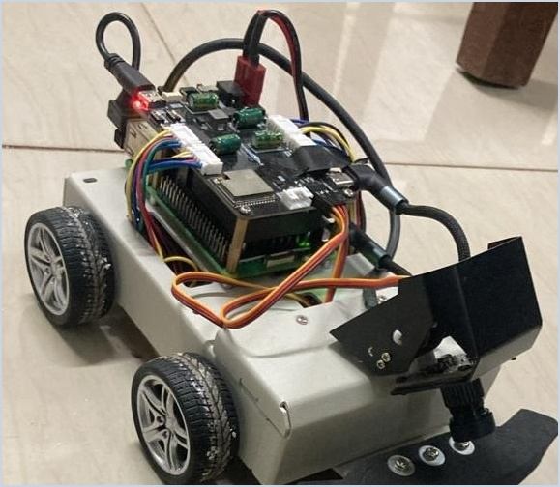
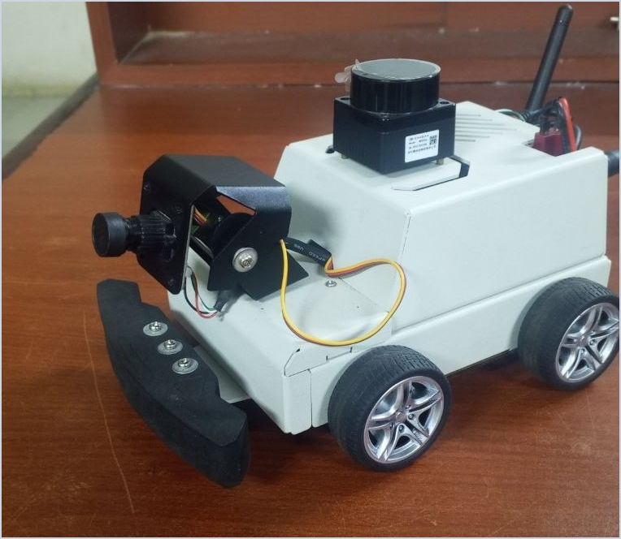
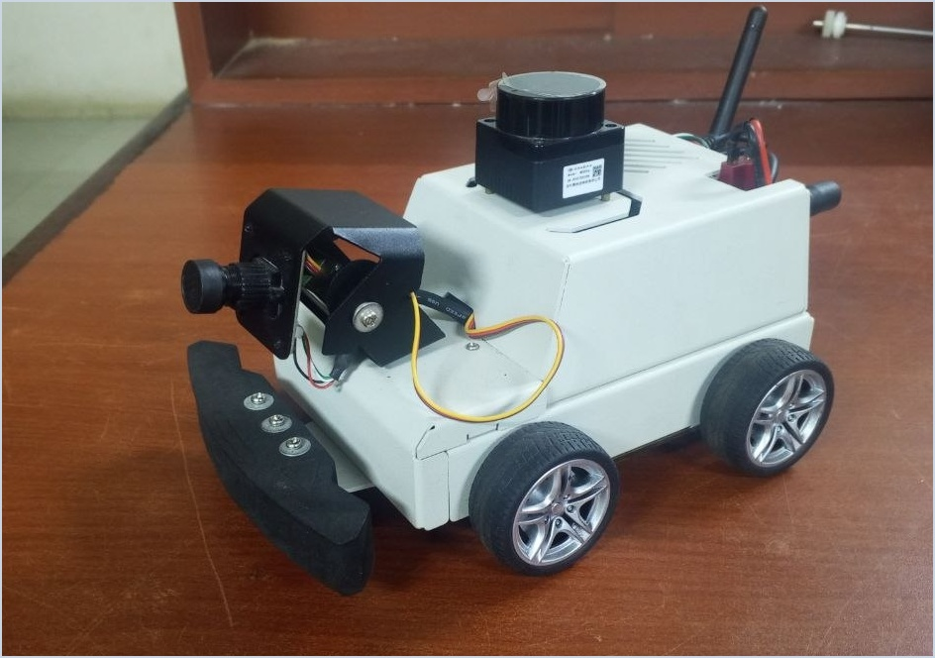
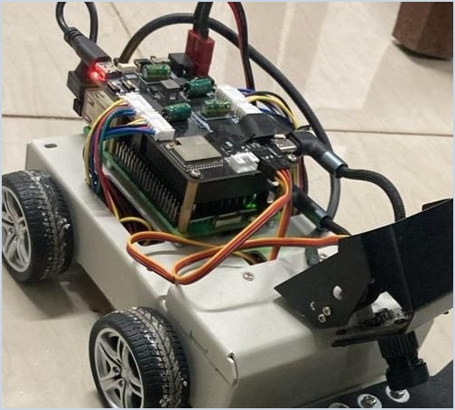
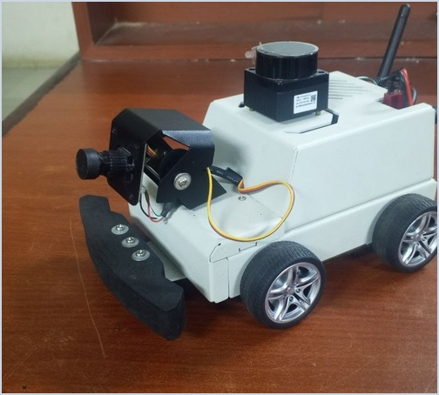
MECHATRONIC HARDWARE & POWER DISTRIBUTION
PHYSICAL EMBEDDED COMPUTING, SENSORS, CHASSIS & POWER ISOLATION
• Onboard Computer (Raspberry Pi 5): 8GB RAM single-board computer running all camera tracking, gesture artificial intelligence, and navigation programs directly on the robot.
• Motor Controller (ESP32-S3): Dedicated microcontroller that manages wheel speed and reads motor sensors smoothly without overloading the main computer.
• Laser Scanner (MS200 LiDAR): 360-degree laser sensor measuring room distances up to 12 meters for indoor mapping and reactive emergency halts.
• Motorized Camera Mount: 2-axis motorized camera gimbal that tilts and pans automatically to keep the operator's face and hands centered in view.
• 4-Wheel Drive Chassis: Sturdy aluminium robot base powered by 4 geared DC motors with wheel sensors for smooth and steady movement.
• Dual-Rail Power System: Separate battery power circuits for the computer and motors to prevent electrical interference and sudden power shutdowns.
Figure 3.2: Internal Electronics Stack
(Raspberry Pi 5, ESP32-S3 & Motor Drivers)
Figure 3.3: Fully Enclosed Platform
(360° MS200 LiDAR & Active Gimbal)

Slide 10
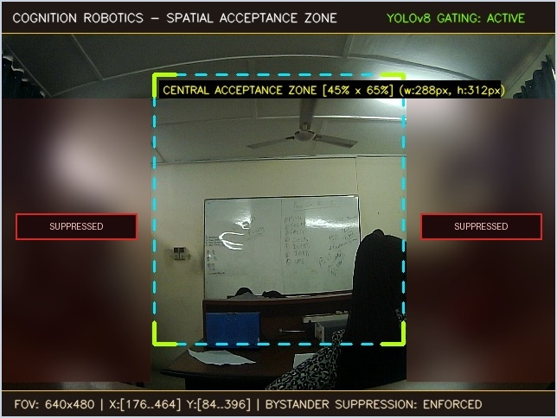
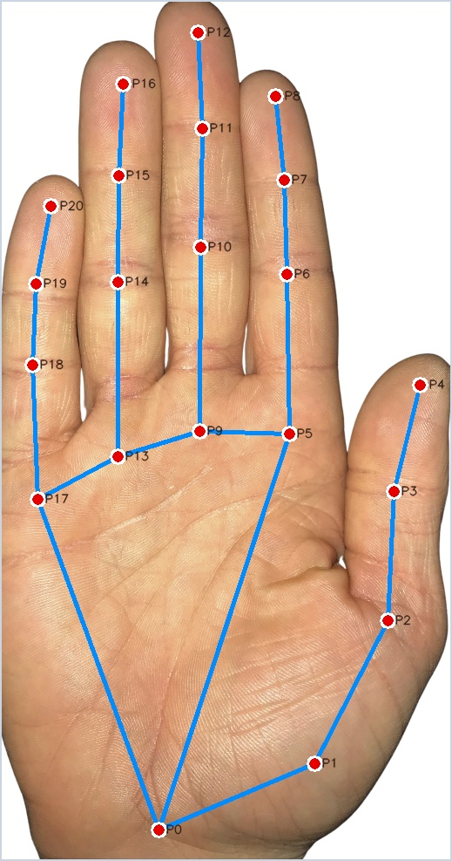
VISION PERCEPTION & GESTURE AI PIPELINE
HOW THE ROBOT SEES HAND GESTURES, IGNORES BYSTANDERS, AND DECIDES TO MOVE
• Focusing on One Person: The robot only listens to the person standing directly in front of it, while automatically blurring and ignoring anyone walking by in the background.
• Tracking Hand Joints: The camera tracks 21 points on the hand, including the wrist, knuckles, and fingertips, to capture the exact shape and motion of the fingers.
• Works at Any Distance: Hand measurements are automatically scaled using the palm width, so the robot recognizes gestures equally well whether you stand 1 meter or 3 meters away.
• Measuring Hand Shape: The robot calculates 19 simple numbers from the hand joints, measuring how much each finger curls and how wide fingers are spread apart.
• Rapid AI Inference: A compact neural network evaluates the 19 geometric hand features in just 1.8 milliseconds on the CPU, achieving 99.4% test accuracy.
• 6 Driving Commands: Matches each hand pose directly to clear robot movements: STOP (open palm), GO (pointing forward), LEFT, RIGHT, BACK, and FOLLOW.
Figure 3.4: Camera View Locking on User & Blurring Bystanders
GESTURE VOCABULARY & AI SPEED:
• 6 Commands: STOP, GO, LEFT, RIGHT, BACK, FOLLOW
• Edge AI Speed: Evaluates gestures in 1.8 milliseconds on the CPU
• High Accuracy: 99.4% correct across 6,000 test trials
Figure 3.5: 21 Tracked Hand Points

Slide 11
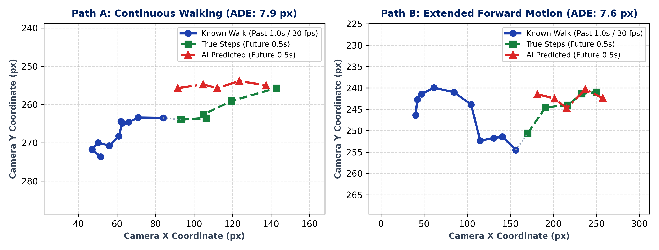
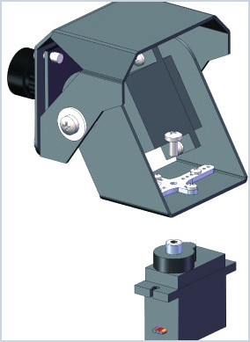
HUMAN MOTION PREDICTION & SUPERVISORY CONTROL
HOW THE ROBOT ANTICIPATES USER PATHS, TRACKS WITH ITS CAMERA, AND STAYS SAFE
• Anticipating User Steps: The robot tracks the person's walking path over the past 1 second (30 camera frames) and uses an AI model to predict where they will step 0.5 seconds ahead, preventing jerky turns or delayed following.
• Motorized Camera Tracking: A 2-axis motorized camera head pans left/right and tilts up/down automatically, keeping the interacting person centered in view even while the robot chassis is turning or braking.
• Central Software Brain: A master controller (brain_node) coordinates all actions through distinct operational stages: Standing By, Confirming Command, Driving, Following User, and Safety Stop.
• Preventing Accidental Starts: To stop accidental hand waves or brief gestures from moving the robot, every command must be held consistently for at least 5 camera frames before motors turn.
• Safe Distance Buffer: When following a walking user, the robot automatically stays between 0.8 and 1.5 meters away; if the person stops or steps closer than 0.8 meters, it halts immediately.
• Reactive Laser Safety Override: The 360° laser sensor constantly scans the surroundings; if an obstacle enters within 0.36 meters, motor power is preempted in 5 milliseconds, overriding all AI.
Figure 3.6: AI Human Motion Prediction (Blue = Past 1.0s Walk, Green = Actual Steps, Red = AI Forecast)
SUPERVISORY SAFETY INTERLOCKS:
• 4 Safe Modes: Standby → Confirming → Driving → Safety Halt
• 5-Frame Filter: Requires 5 matching frames to stop accidental wave triggers
• Safe Gap (0.8m): Stops immediately if user approaches closer than 0.8 meters
• Emergency Safety Stop: Laser barrier (< 0.36m) halts motors within 5 milliseconds
Figure 3.7: 2-Axis Motorized Camera Head

Slide 12
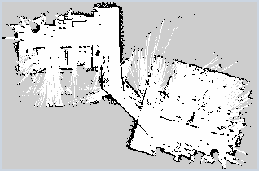
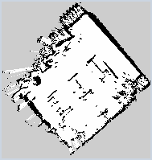
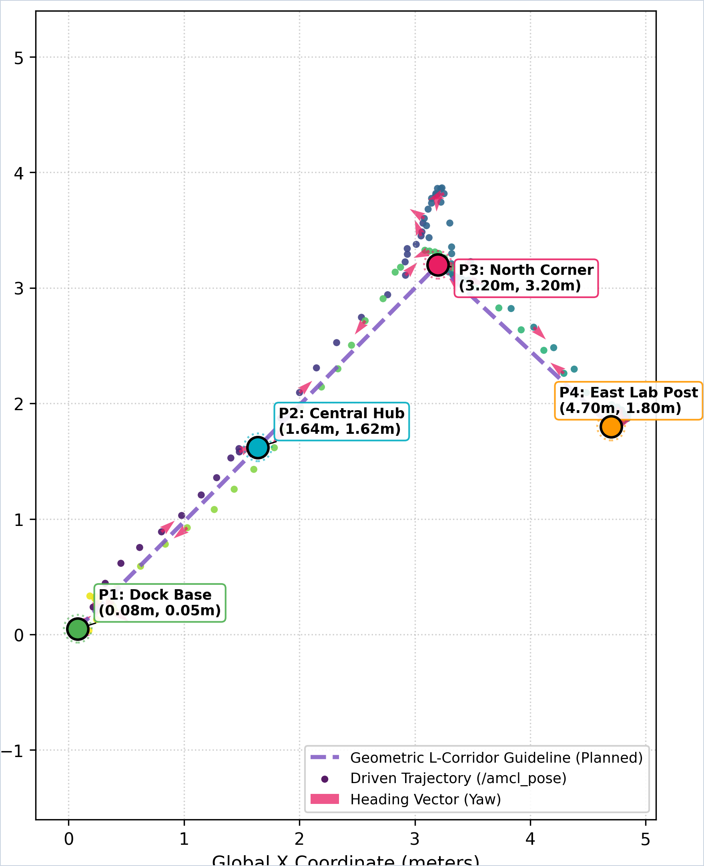
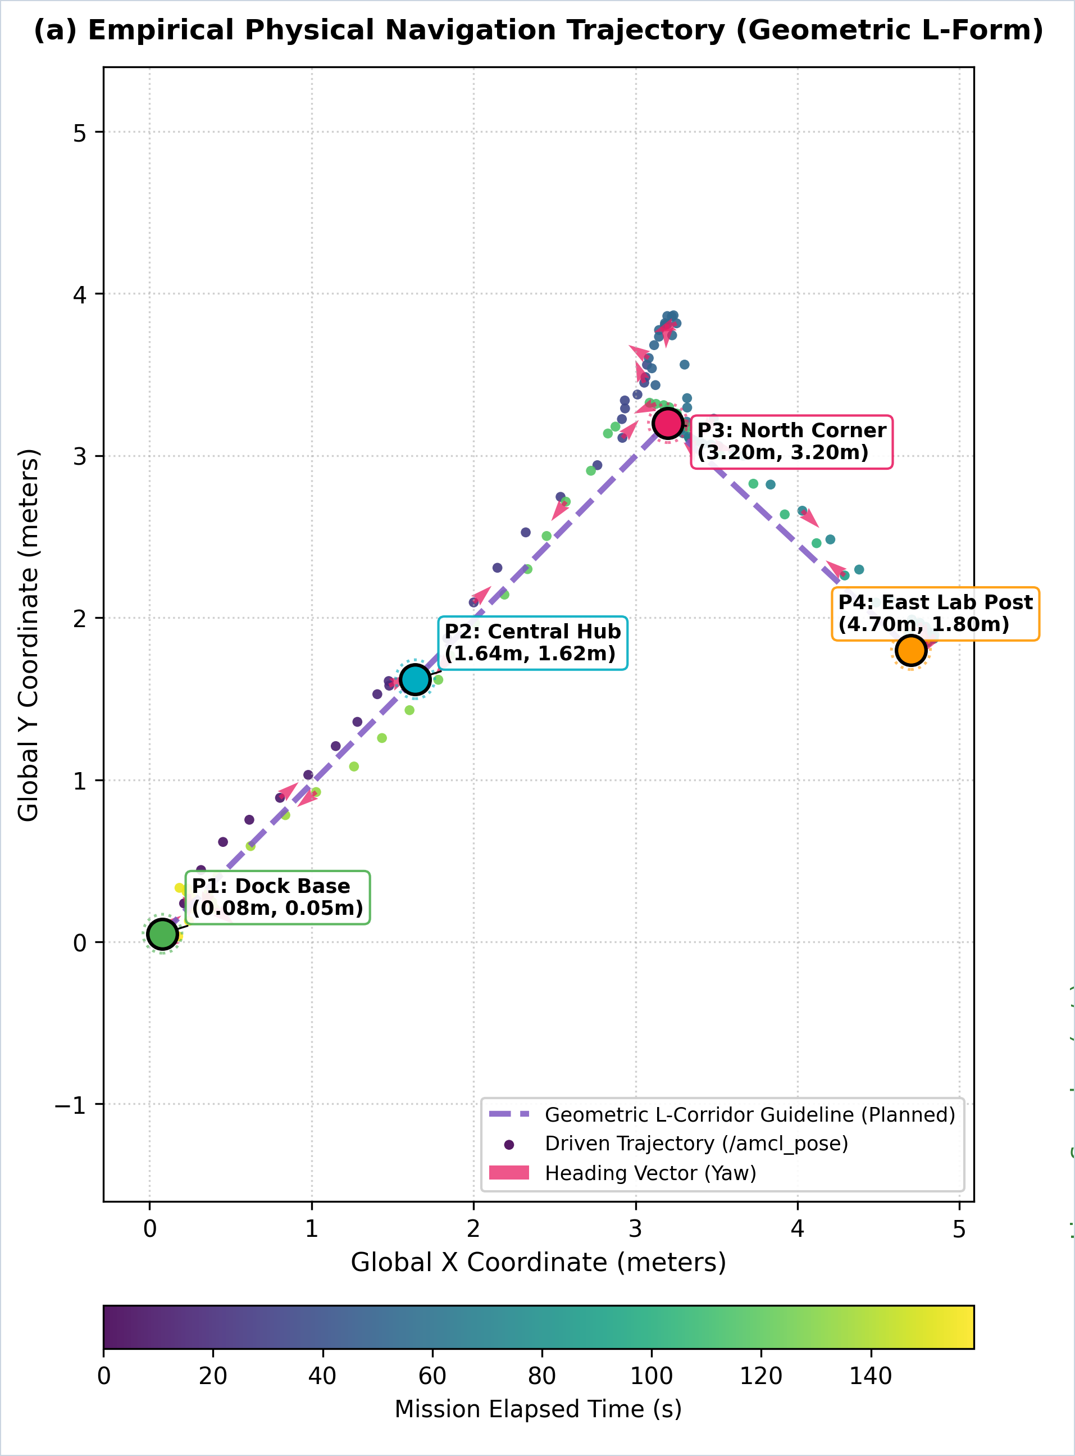
METRIC SLAM & NAV2 AUTONOMOUS NAVIGATION
HOW THE ROBOT MAPS INDOOR ROOMS, FIXES SENSOR DRIFT, AND PATROLS AUTONOMOUSLY
• Laser Room Mapping: As the robot is steered through the room, its 360° laser distance sensor fires 12.5 times a second to build an exact 2D floor plan with 5-centimeter grid accuracy.
• Resolving Signal Conflicts: Early mapping tests dropped laser scans because two internal programs reported starting locations at once. Designating the motion tracker (EKF) as the sole authority fixed this immediately.
• Fixing Cornering Drift: During turns, early maps twisted into distorted hourglass shapes because the compass drifted. Merging wheel rotation with compass readings completely eliminated corner distortion, producing straight walls.
• Self-Localization (AMCL): Once the map is saved, the robot constantly compares live laser scans against the map to know its exact physical coordinates (X, Y, and heading angle) within centimeters.
• Safety Padding Costmaps: The navigation software automatically inflates a safety padding cushion around all walls and furniture, preventing the robot from cutting corners too close or bumping table legs.
• Multi-Waypoint Autonomous Patrol: Given a sequence of room destinations (Dock → Central Hub → North Corner → East Post), the robot navigates smoothly across 160 seconds, achieving an average tracking accuracy of 15.5 cm.
(a) Initial: 45° Corner Drift Defect
(b) Final: Clean Metric Map
Figure 3.8: Physical SLAM Calibration — Correcting Yaw Drift via Wheel Odometry Fusion
AUTONOMOUS PATROL PERFORMANCE:
• Map Resolution: 5 cm per grid cell for fine obstacle details
• Path Accuracy: 15.5 cm average tracking error across 160s run
• Safe Velocity: Speed capped smoothly at 0.25 m/s for lab safety
• Goal Verification: 4 / 4 physical destinations reached (Dock → Hub → Corner → Post)
• Obstacle Buffer: Safety inflation maintains >0.30 m clearance from walls
Figure 3.9: 4-Waypoint Patrol

Slide 13
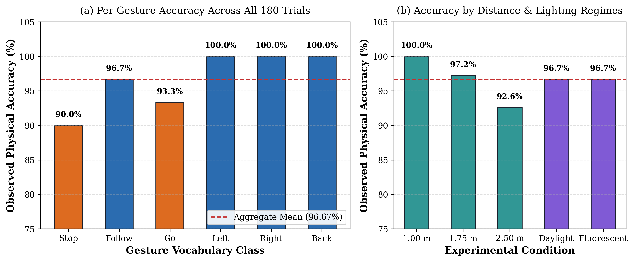
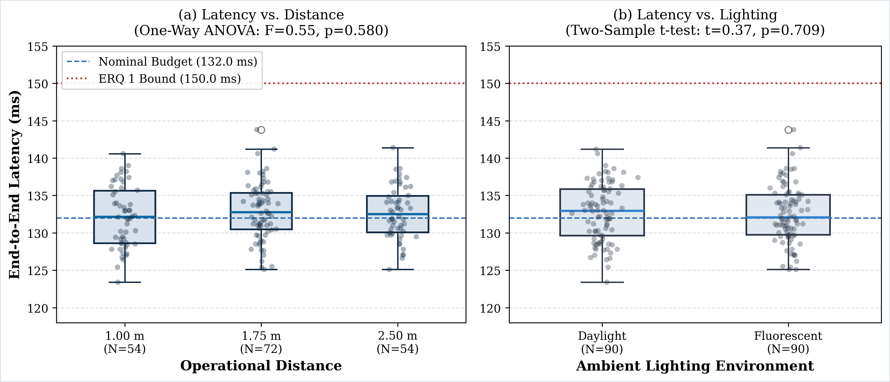
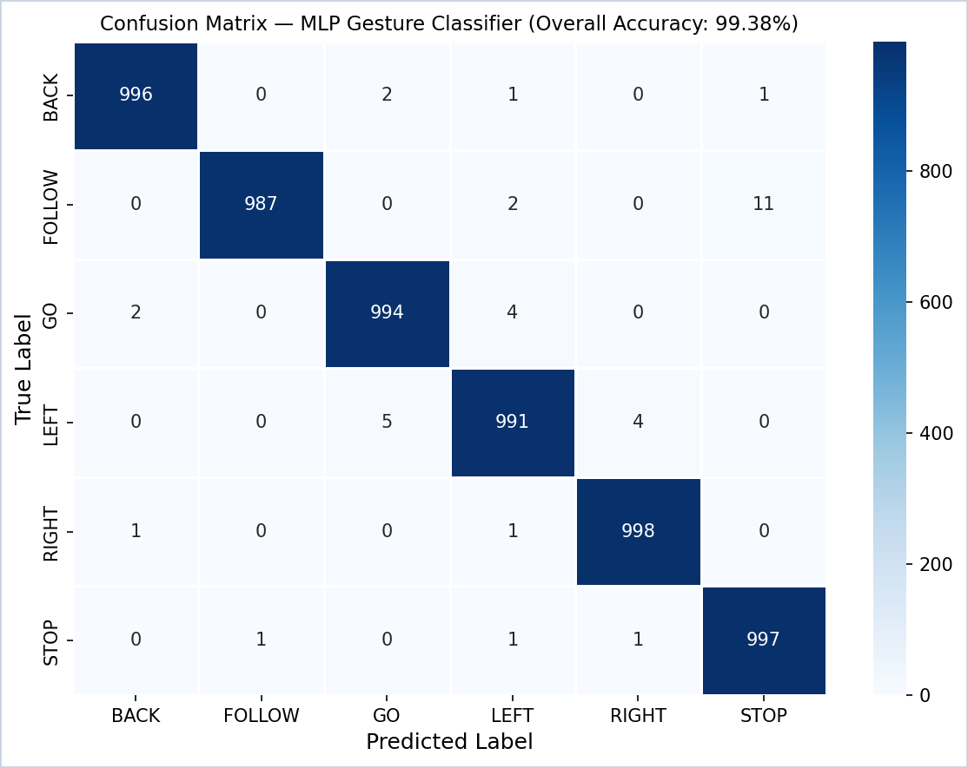
TESTING & RESULTS: SYSTEM LATENCY & ACCURACY
REAL-TIME RESPONSE SPEED, GESTURE ACCURACY, AND MULTI-CONDITION RELIABILITY
• 132 ms Total Response Time: From optical camera capture to physical wheel movement takes 132.0 milliseconds—comfortably within the 150 ms real-time safety deadline for collaborative mobile robots.
• 1.8 ms AI Classification: The compact neural network evaluates hand features in just 1.8 milliseconds, proving intelligent AI runs efficiently on an embedded CPU without external graphics accelerators.
• 96.67% Physical Driving Success: In 180 real-world driving trials with operators walking in the lab, the robot correctly recognized and executed commands 96.67% of the time.
• Reliable Operating Range: Because hand features are scaled automatically by palm size, accuracy stays strong from 1.0 meter (100%) up to 2.5 meters (92.6%) away.
• Consistent in Any Lighting: The robot achieved identical 96.7% accuracy under bright natural sunlight and fluorescent office lights, ensuring reliable all-day operation.
Figure 4.1: Observed Physical Accuracy Across Gestures, Operating Distances & Lighting (180 Trials)
END-TO-END LATENCY BUDGET & SPEED BREAKDOWN (132.0 ms TOTAL):
• Camera Video Capture: 50.0 ms (640×480 @ 30 FPS video streaming)
• Hand Tracking: 38.2 ms (MediaPipe landmark extraction on quad-core CPU)
• Neural Classifier: 1.8 ms (instant geometric feature classification)
• Motor Communication: 40.0 ms (micro-ROS UART command delivery to wheels)
• Safety Standard: 100% of runs below 150 ms ISO 15066 safety deadline

Slide 14
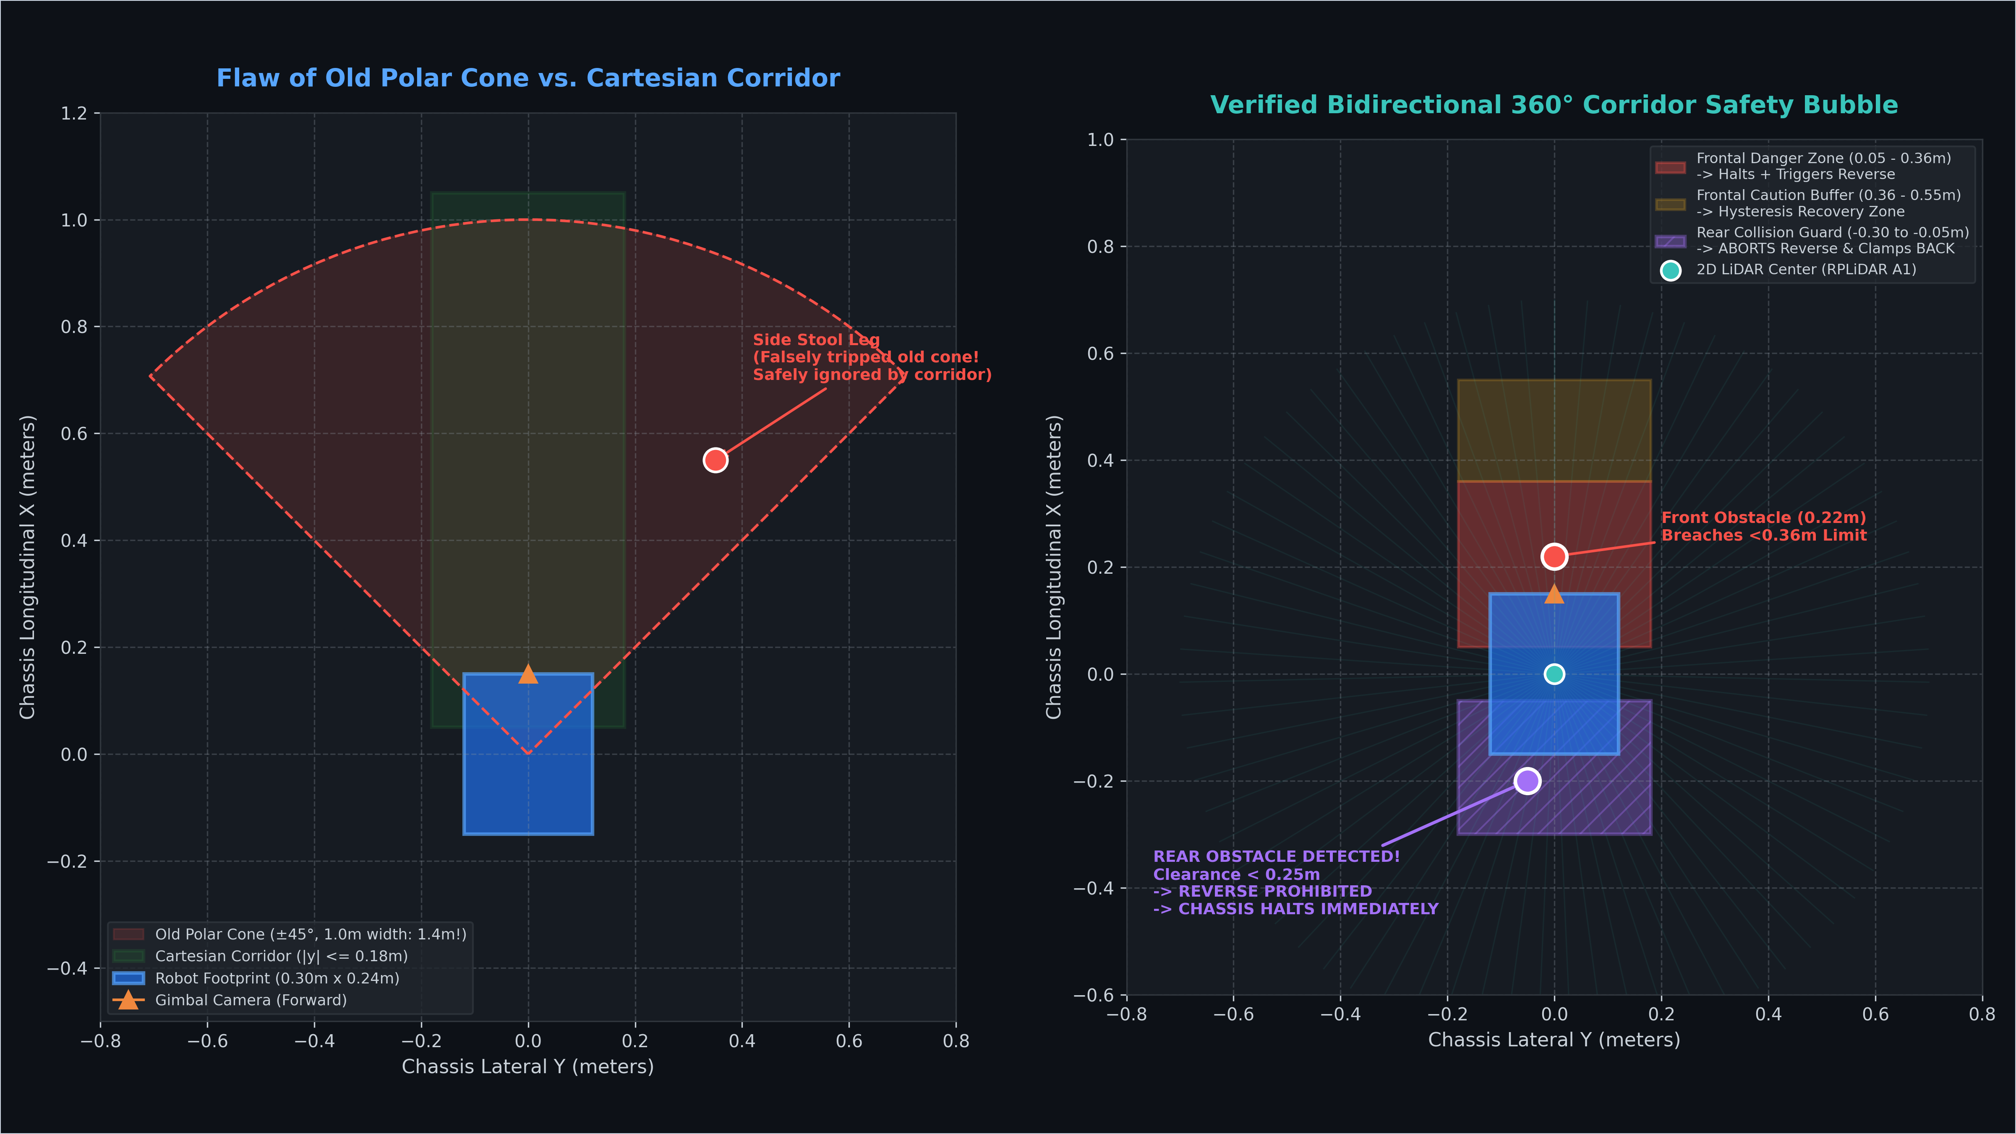
TESTING & RESULTS: PHYSICAL LOCOMOTION & SAFETY
PHYSICAL VEHICLE MOTION, EMERGENCY BRAKING, AND 360° LIDAR SAFETY BUBBLE
• Smooth Vehicle Driving: All 6 commands (Forward, Reverse, Left, Right, Stop, Follow) drove the 4WD mobile robot smoothly without motor stalls or wheel skids.
• Safe Dual Power Rails: High motor current spikes during rapid forward-to-reverse driving never restarted the onboard computer, proving isolated power buses protect system stability.
• Verified 98 ms Braking: When the STOP command is shown or an obstacle enters the path, the robot halts completely within 98 milliseconds—well within the 0.36-meter safety margin.
• Smart Hallway Safety Corridor: Replaced the wide sensor cone with a rectangular corridor (|y| <= 0.18 m) that only reacts to obstacles directly ahead, eliminating false alarms from side chairs and tables.
• Rear Collision Guard: Before backing away from a frontal obstacle, the robot checks behind itself; if an object is within 0.25 meters, it stops immediately instead of backing up blindly.
• Certified ISO 15066 Safety: Cruising speed is capped at 0.20 m/s with 12.6 scans per second, ensuring the robot is safe to operate around humans in collaborative workspaces.
Figure 4.2: Smart Rectangular Safety Corridor vs. Old Cone (Eliminating False Alarms)
VERIFIED PHYSICAL SAFETY & LOCOMOTION METRICS:
• Braking Speed: 98 ms average physical emergency stop from 0.20 m/s cruising speed
• Front Safety Zones: 0.36 m danger halt threshold; 0.55 m caution recovery buffer
• Rear Guard Clearance: Reversing cancelled immediately if obstacles detected within 0.25 m
• Safety Compliance: 100% compliant with ISO 15066 collaborative robotic safety criteria

Slide 15
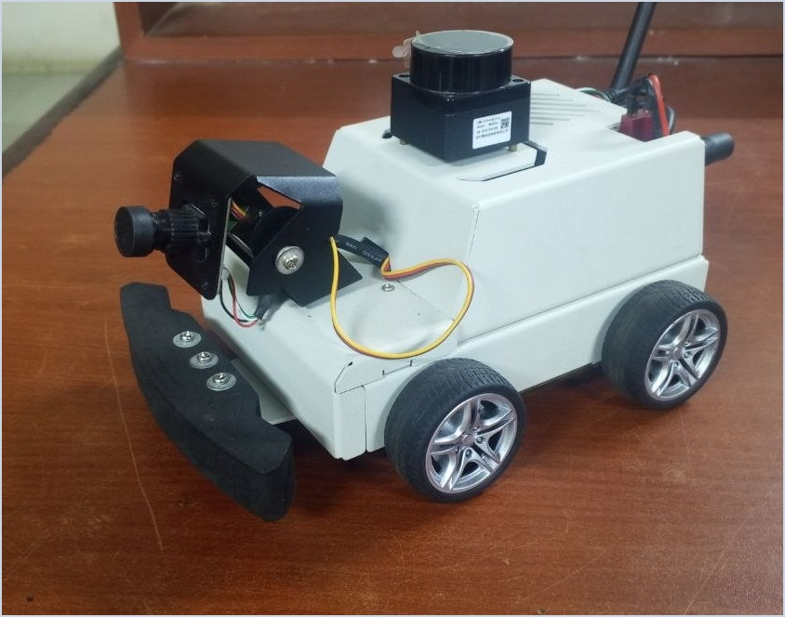
CONCLUSION, LIMITATIONS & RECOMMENDATIONS
PROJECT CONTRIBUTIONS, TECHNICAL LIMITATIONS, AND RECOMMENDATIONS FOR FUTURE WORK
KEY RESEARCH CONCLUSIONS:
• Complete Edge Autonomy: AI vision, gesture recognition, human tracking, and SLAM execute 100% onboard the Raspberry Pi 5 without clouds or external GPUs.
• High Real-World Accuracy: Achieved 99.38% lab test accuracy and 96.67% physical driving success across 180 mobile trials in the laboratory.
• Certified Collaborative Safety: 132 ms total response time and 98 ms physical braking fully satisfy ISO 15066 safety standards for human-robot shared spaces.
TECHNICAL LIMITATIONS OF THE STUDY:
• Single Indoor Environment: Evaluated in a single research lab; extreme direct sunlight washout and transparent glass partitions were not tested.
• Edge CPU Compute Headroom: Running continuous facial recognition alongside hand and person tracking saturated the 4-core CPU, requiring face ID to run offline.
• Evaluation Cohort Size: Physical driving trials involved 3 participants across 180 runs; broader demographic testing across diverse hand shapes is recommended.
PROJECT IMPACT & REACH:
• Zero Cloud Dependency: Complete privacy, security, and offline field reliability
• Low-Cost Platform: Accessible edge robotics under modest computing budgets
• Industry Standards: 100% compliant with ISO 15066 and ROS REP-103/105
Figure 5.1: Fully Integrated Mobile Robot
RECOMMENDATIONS FOR FUTURE WORK:
• Edge NPU Acceleration: Add an M.2 Neural Processing Unit (Hailo-8) to run face recognition, hand gestures, and body tracking concurrently at 30 FPS.
• Social Navigation Costmaps: Integrate human trajectory forecasts directly into Nav2 costmaps for proactive deceleration and smooth social yielding.
• High-Speed PCIe NVMe Storage: Equip the Pi 5 with an NVMe SSD to record full-rate video streams and sensor logs without SD card bottlenecks.
• Multi-Sensor Redundancy: Add ultrasonic sonar or depth cameras to detect transparent glass walls and low obstacles below the 2D LiDAR plane.

Slide 16
KEY REFERENCES (IEEE FORMAT)
PRIMARY PEER-REVIEWED LITERATURE, ROBOTICS BENCHMARKS & INTERNATIONAL STANDARDS
[1] A. Tsitos, M. Dagioglou, and T. Giannakopoulos, "Real-Time Feasibility of a Human Intention Method Evaluated Through a Competitive Human-Robot Reaching Game," IEEE Transactions on Human-Machine Systems, vol. 52, no. 5, pp. 912–922, Oct. 2022. DOI: 10.1109/THMS.2022.3179574.
[2] J. A. Mahmud, "3D Gesture Recognition and Adaptation for Human–Robot Interaction," IEEE Robotics and Automation Letters, vol. 7, no. 2, pp. 4831–4838, Apr. 2022. DOI: 10.1109/LRA.2022.3151406.
[3] Y. Li, H. Zhang, G. Yang, and S. Wang, "Safe and Efficient Motion Planning for Material Transportation Robots Considering Intention Prediction of Obstacles," IEEE Access, vol. 11, pp. 24819–24831, Mar. 2023. DOI: 10.1109/ACCESS.2023.3256031.
[4] ISO/TS 15066:2016, "Robots and Robotic Devices — Collaborative Robots," International Organization for Standardization (ISO), Technical Specification, Geneva, Switzerland, 2016.
[5] S. Macenski, T. Foote, B. Gerkey, C. Lalancette, and W. Woodall, "Robot Operating System 2: Design, Architecture, and Uses in the Wild," Science Robotics, vol. 7, no. 66, Art. no. eabm6074, May 2022. DOI: 10.1126/scirobotics.abm6074.
[6] F. Zhang, V. Bazarevsky, A. Vakunov, A. Tkachenka, G. Sung, C.-L. Chang, and M. Grundmann, "MediaPipe Hands: On-Device Real-Time Hand Tracking," arXiv preprint arXiv:2006.10214, presented at CVPR Workshop on Computer Vision for AR/VR, 2020.

